Slide 1
FRB Update #17
William Huang
(9/21/2020)

Slide 2
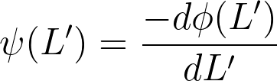
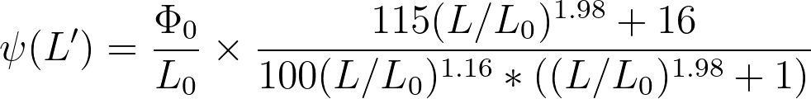

Calculating Differential LF
Using the fitted curve for the cumulative LF for FRBs,
I took the derivative and found that
Using the units that is already in, and erg/s for L0.

Slide 3
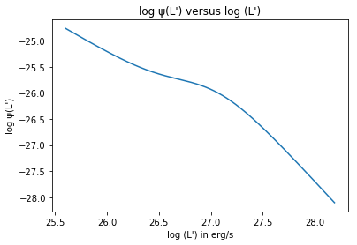
Calculating Differential LF (continued)
I obtained the following graph for the differential LF. The differential LF seems to be monotonically decreasing, with a slight bump at 10^27 erg/s.

